Slide 1

IOT microservices in power transmission
PV217 Soa
Team 3 - Michal Randák, Jalal Nabiyev, Marcel Mráz

Slide 2
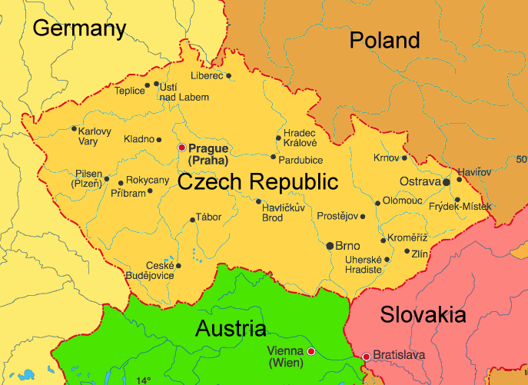
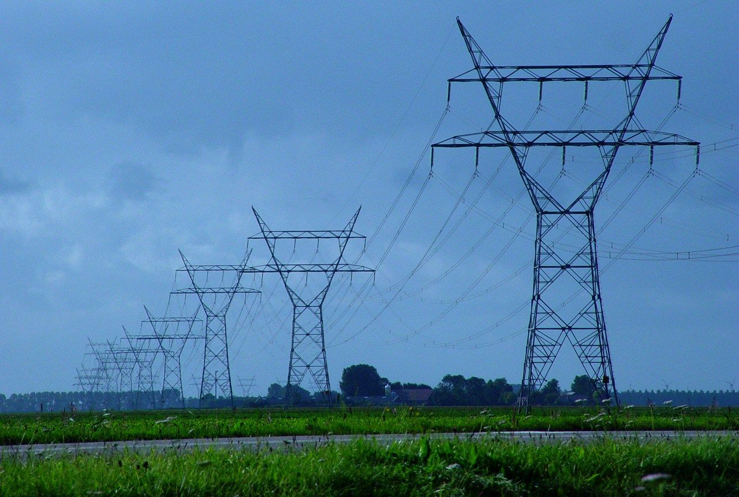
Project domain
Power transmission industry
Border flow measurements
Real-time operators monitoring

Slide 3
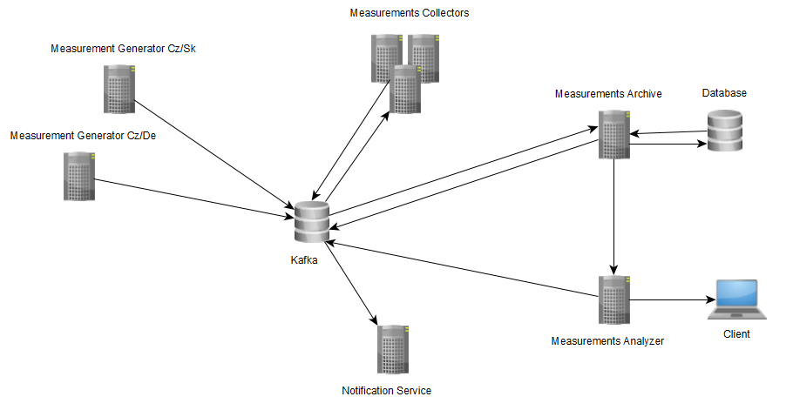
Architecture
Microservices in docker
Generator Service (Quarkus)
Collector Service (Quarkus)
Archiver Service (Quarkus)
Analyzer Service (Quarkus)
Notification Service (Node.js)

Slide 4
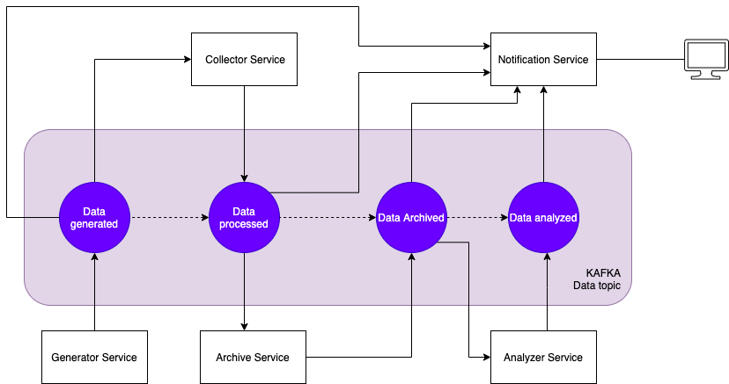
Architecture
Communication mostly Async
Kafka handling messages

Slide 5
Requirements
The project has to be deployed with Docker/Podman (all services)
Deployment on Kubernetes/Minikube or Openshift/CRC (not implemented)
Have the API design & contract available in the project documentation (all relevant services)
Have some monitoring part for the services collecting metrics about usage (all quarkus services)
Have at least one service that can show self-healing capabilities (analyzer)
All services have some meaningful tests running (limited unit tests)
Have some simple database support for at least one service (archiver)

Slide 6
Requirements
Process monitoring data and visualization with Prometheus + Grafana (not implemented)
Use Jaeger for tracing (not implemented)
Use of Kafka for asynchronous messaging (all services)
Use of authentication for some microservices with JWT (not implemented)
Showcase of reactive properties: self-healing (analyzer), elasticity (collector and notif-client), message-driveness (all)
GraalVM (not used)

Slide 7




Practical showcase

Slide 8

Links
- GitHub https://github.com/Mrazator/iot-microservices-kafka

